Slide 1
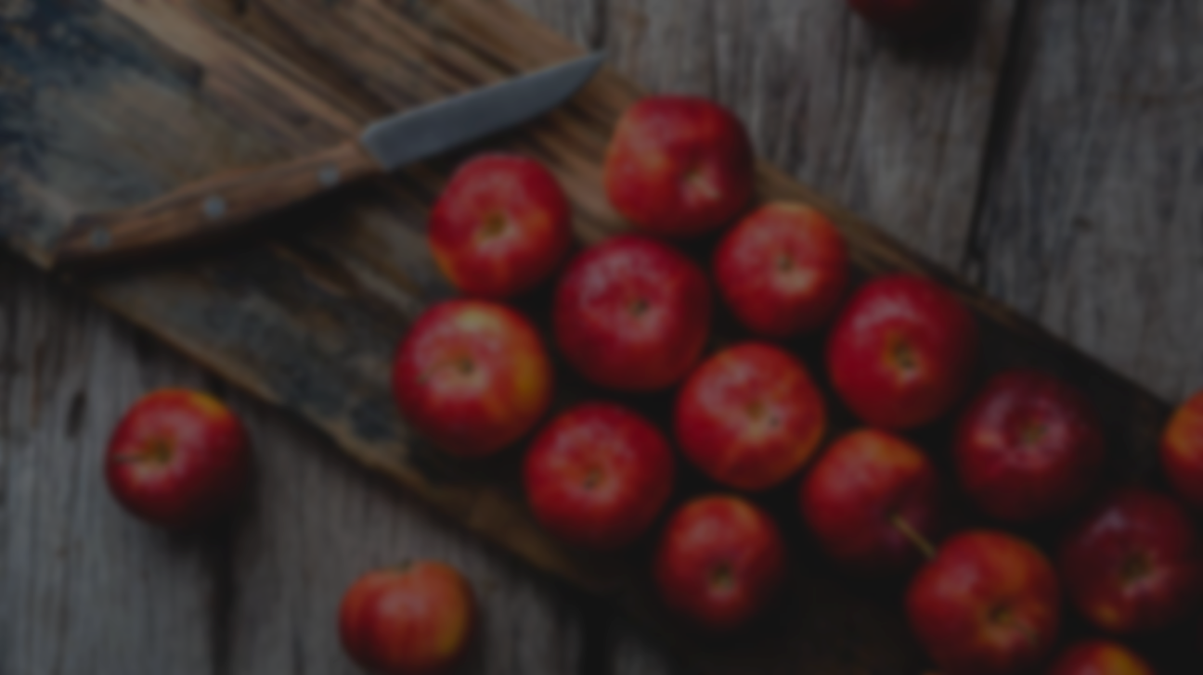


Prediction of Apple Sweetness, Using Deep Learning
2023.06.06
DLIP Final Project Presentation
21800226 YunKi Noh
21801017 EunChan Kim

Slide 2
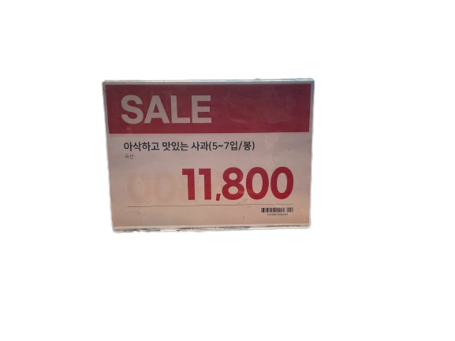
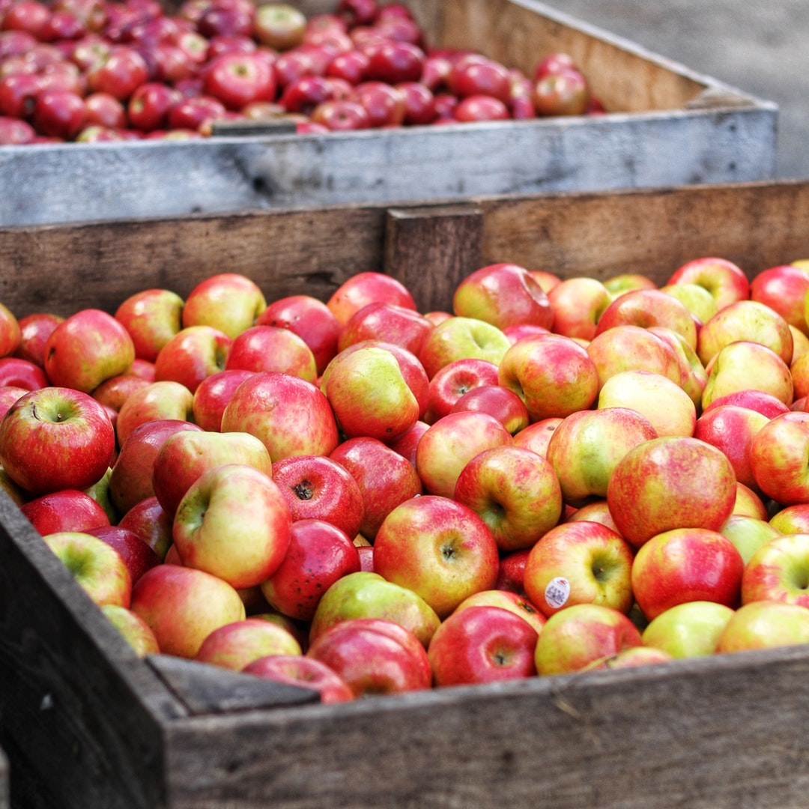
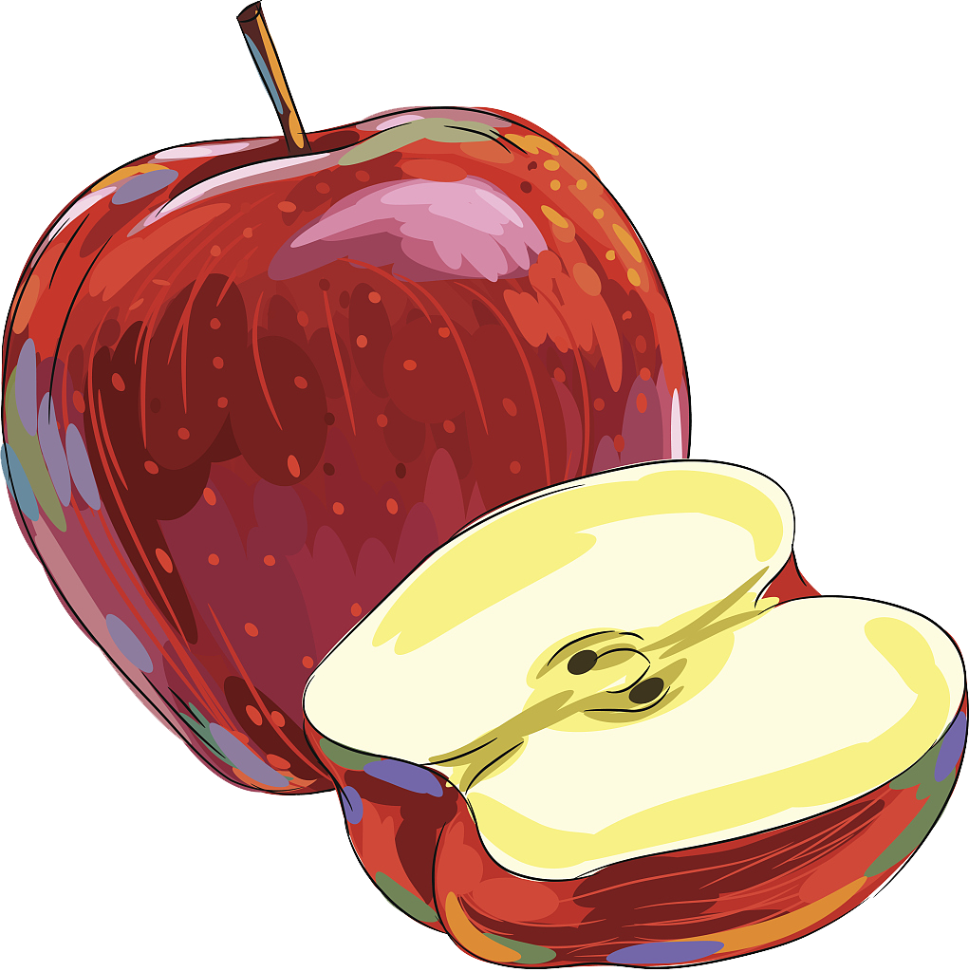
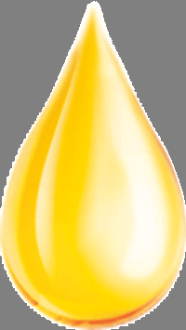



Background
DLIP Final Presentation
Question: How to know which apple is sweater?
“If customer can check each apple’s sweetness,
they can determine their choice with more confidence”
: Damage to Apple
: no damage, but expensive
: not Damage and not expensive

Slide 3
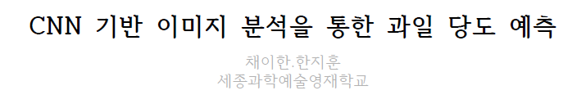
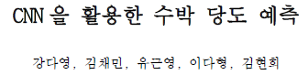
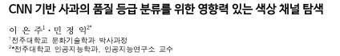
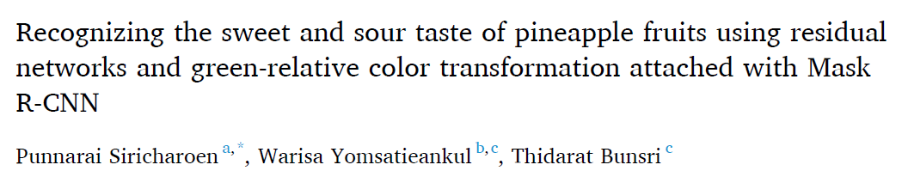
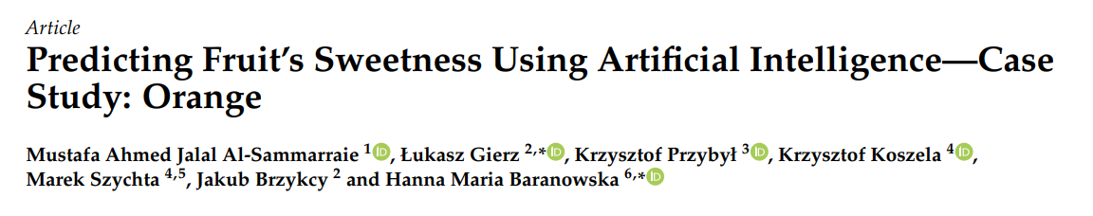
Preceding Study
DLIP Final Presentation
Most of them are classification problems
Most of the regression predictions use CNNs
According to this paper, RGB is the color area that reflects the quality of apples the most

Slide 4
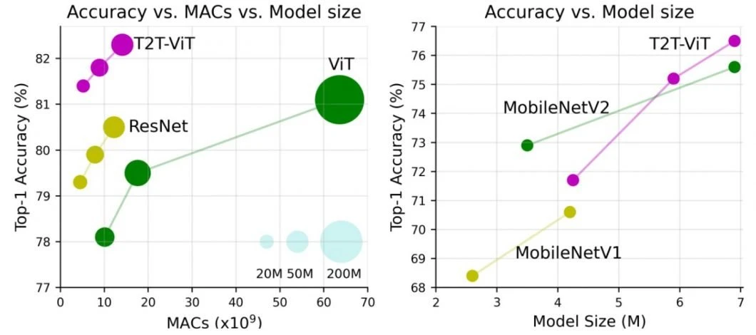
Achievement Goal
DLIP Final Presentation
1. Train Error: under 2 [MSE loss]
2. Evaluation Error: under $±$ 5% Brix Error
3. Use variable deep learning model
4. User-friendly system
Train Output
Train loss :
(MSE)
ResNet50 > DensNet > VGG16 > Inception v3
5.07
5.24
8.36
11.03

Slide 5
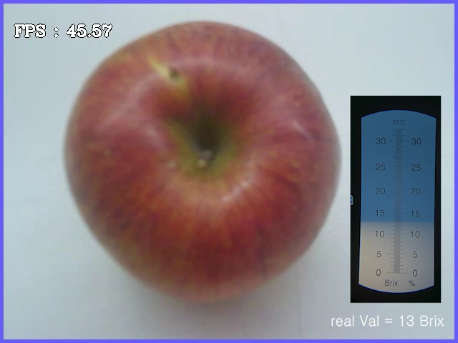
Demo Video
DLIP Final Presentation

Slide 6
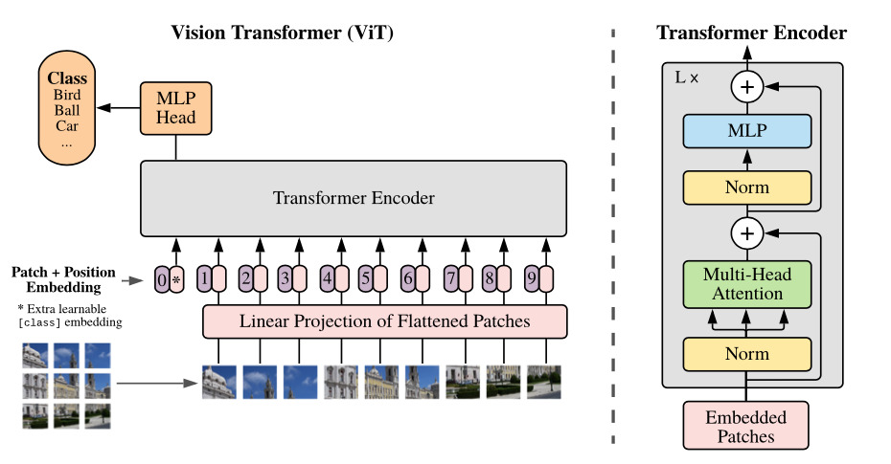
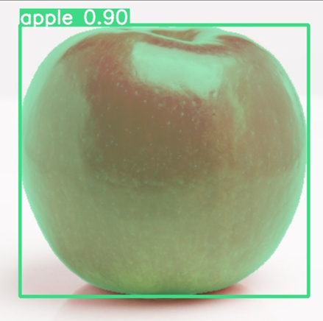
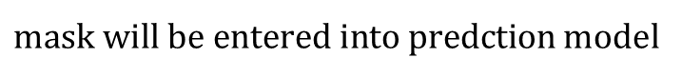
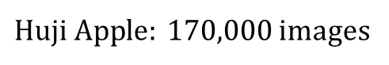
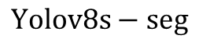
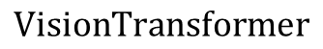
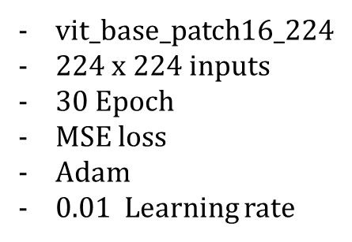
Modeling
DLIP Final Presentation
1st. Datasets
3rd. Brix prediction(Regression)
$Huji Apple: 170,000$images
$$VisionTransformer$$
Mask segmentation labeling data
2nd. Segmentation(Classification)
$$Yolov8s−seg$$
$mask will be entered into predction$ model
vit_base_patch16_224
$224$ x 224 inputs
30 Epoch
MSE loss
Adam
0.01 Learning rate

Slide 7
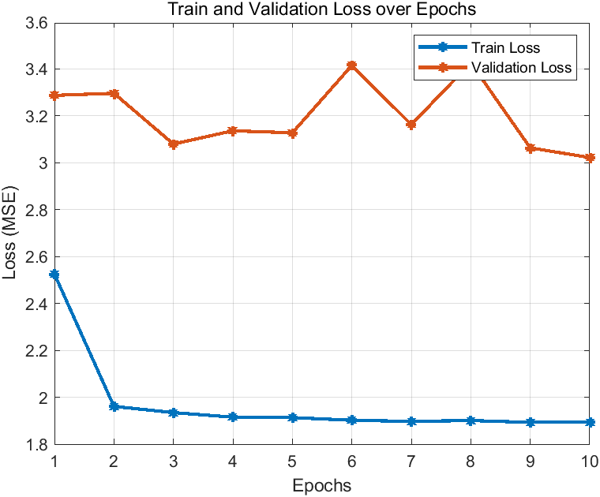
Result
DLIP Final Presentation
1. Graph
 | Train Error[MSE] | Validation Error[MSE] | Evaluation Error[%]
목표 | Under 2 | No Overfitting | Under 5%
결과 | 1.89 | 3.02 | 5.08
달성여부 | O | O | X
2. Chart
Light(X) | 1(U8) | 2(U2) | 3(U4) | 4(U6) | 5(U7) | 6(U5) | 7(U9) | 8(A4) | 9(A2) | 10(A3)
Real[brix] | 12.5 | 13.0 | 13.7 | 11.0 | 12.0 | 10.0 | 14.2 | 11.0 | 13.0 | 12.0
Pred[brix] | 12.44 | 12.76 | 13.15 | 11.71 | 12.16 | 11.53 | 14.12 | 11.7 | 12.88 | 13.63
Error[%] | 0.48 | 1.85 | 4.01 | 6.45 | 1.33 | 15.3 | 0.56 | 6.36 | 0.92 | 13.58
Total[%] | 5.08

Slide 8
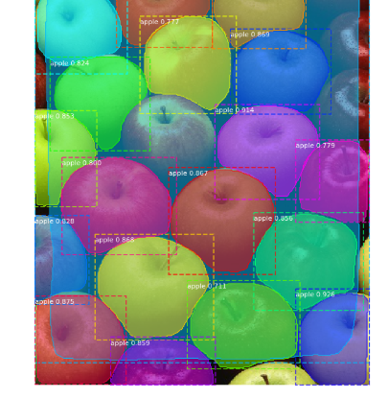
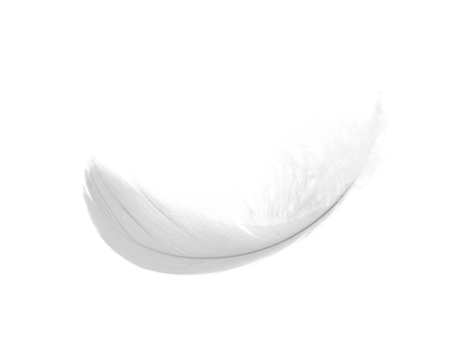
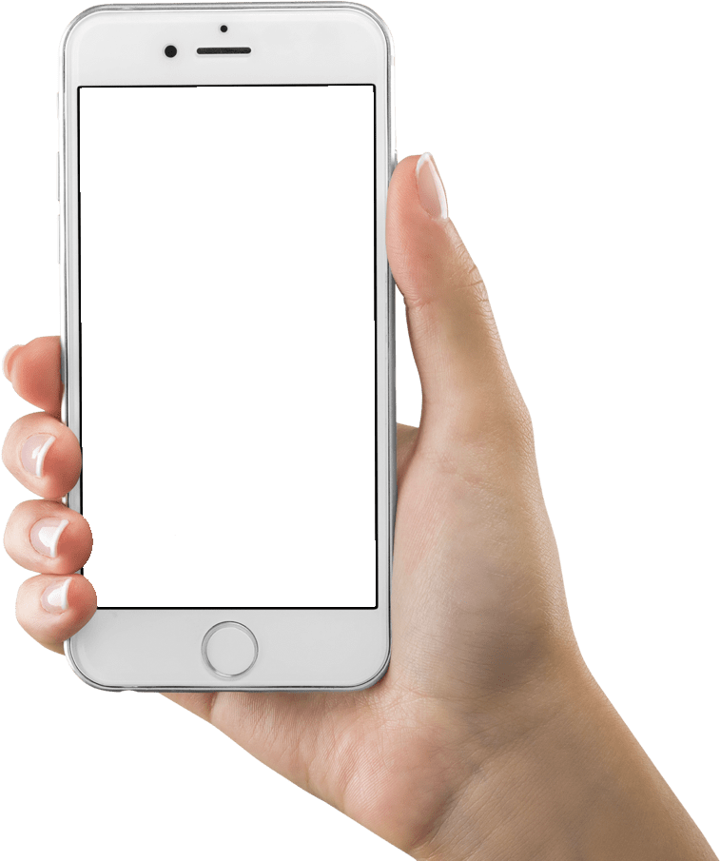
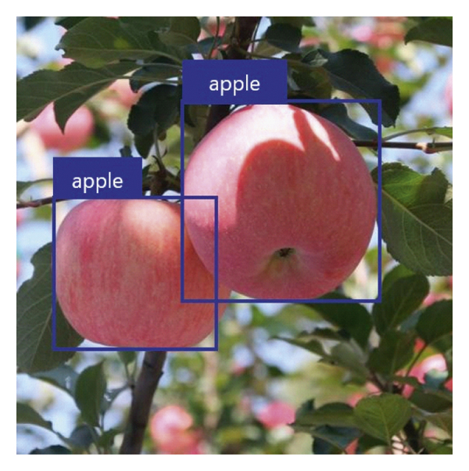

Supplementation
DLIP Final Presentation
Instance Segmentation
Light Model
User friendliness
Developing
train model

